Slide 1
OpenChain Monthly Meeting
Southeast Asia Work Group
Thursday 22 October 2026 @ 20:00 SGT, 13:00 UK, 07:00 CT US
Notes:
Hello everyone. Welcome to the OpenChain Southeast Asia Work Group meeting. I’m Jimmie Wang. Thank you for joining us today.

Slide 2
Anti-Trust Policy Notice
Linux Foundation meetings involve participation by industry competitors, and it is the intention of the Linux Foundation to conduct all of its activities in accordance with applicable antitrust and competition laws. It is therefore extremely important that attendees adhere to meeting agendas, and be aware of, and not participate in, any activities that are prohibited under applicable US state, federal or foreign antitrust and competition laws.
Examples of types of actions that are prohibited at Linux Foundation meetings and in connection with Linux Foundation activities are described in the Linux Foundation Antitrust Policy available at http://www.linuxfoundation.org/antitrust-policy. If you have questions about these matters, please contact your company counsel, or if you are a member of the Linux Foundation, feel free to contact Andrew Updegrove of the firm of Gesmer Updegrove LLP, which provides legal counsel to the Linux Foundation.
Notes:
Before we begin, please take a moment to review the Linux Foundation’s antitrust notice. Please follow the policy throughout our discussion.

Slide 3
Agenda
Introduction to OpenChain and latest project updates
Initial plans for the Southeast Asia Work Group
Open discussion on open source supply chains, security, AI supply chains, and regional collaboration
Notes:
We’re pleased to have Mary Wang, Executive Director of the OpenChain Project, joining us today. Mary will give a short introduction before we begin.
Mary, thank you for joining us. Over to you!
Thank you, Mary, for sharing your thoughts.
In my early conversations with local open source friends, I found that many are still getting to know OpenChain. So today, I’ll briefly introduce the project and share our initial plans for the Southeast Asia Work Group.
Then we’ll open the discussion to hear your questions, local needs and ideas for collaboration.

Slide 4
OpenChain Vision + Mission
Our vision is a trusted supply chain
Our mission is to make that happen
This makes a cheaper, faster, more efficient supply chain… for everyone
Project Charter:
https://github.com/OpenChain-Project/Project-Charter-And-Agreements/blob/master/Project-Charter/OpenChain-Charter-March2020.pdf
Notes:
Let’s start with the problem OpenChain helps us address: how to build trust when software moves between teams and organizations.
OpenChain’s vision is a trusted supply chain. As a Linux Foundation project, it helps organizations establish clear processes for managing open source. Shared expectations can make collaboration easier and reduce repeated work.

Slide 5
Our Mental Model Of The Supply Chain
Notes:
We often picture a supply chain as a simple line: a supplier provides software, we build a product, and a customer receives it.

Slide 6
Notes:
But each participant also depends on other software and organizations. Those dependencies add more connections than a simple chain can show.

Slide 7

The Actual Supply Chain
Notes:
The real supply chain looks much more like this: a complex network of shared dependencies. A problem in one widely used component can create work for many downstream organizations.

Slide 8
Security Assurance Is Increasingly Urgent
eMudhra CA Key Compromise CVE-2026-111943 CVE-2026-91403
  Weak private keys for eight intermediate CAs exposed clients still trusting them to forged HTTPS certificates.
PHP Critical Vulnerabilities CVE-2026-109618 CVE-2026-109619
  Two flaws could allow unauthenticated remote code execution. PHP released emergency fixes on 21 October 2026.
Operating systems
Base libraries and Runtime
ca-certificates, nss
Go, Python, Rust, Java, Node.js
php packages
Browsers
PHP runtimes and web services
Container and cloud images
Notes:
Two recent incidents show how far that impact can spread.
The eMudhra incident involved weak private keys for eight intermediate certificate authorities. Clients still trusting those keys could accept forged HTTPS certificates. Responding required coordinated trust updates across browsers, operating systems and other software.
On 21 October, PHP released fixes for two critical vulnerabilities that could allow remote code execution without authentication. Downstream maintainers needed to update runtime packages, while operators needed to update and restart affected services.
Affected container and cloud images also need updates. The response reaches well beyond the original component, so knowing what we use and who is responsible matters.

Slide 9
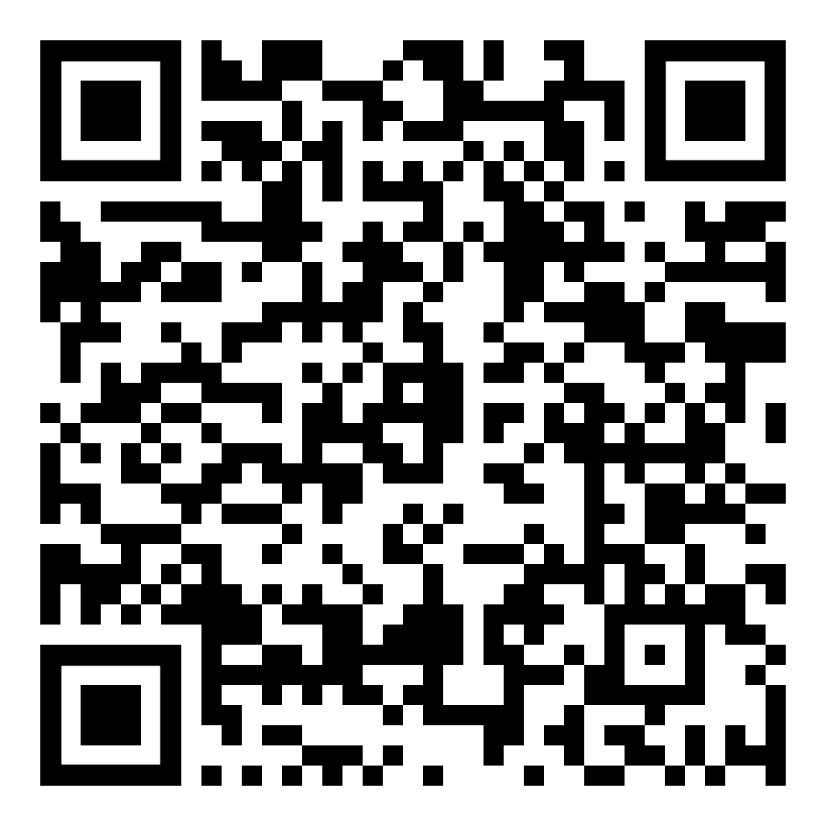
Global Codebase Statistics
98% use open source
68% have license compliance issues
87% have security issues
Black Duck OSSRA Report 2026
Notes:
The report gives us a wider view. Among the codebases it analyzed, 98 percent used open source, 68 percent had license compliance issues, and 87 percent had security issues. These findings show why organizations need ongoing management of open source.

Slide 10
We Needed To Improve Trust In The Supply Chain
Notes:
Customers need confidence in how their suppliers manage open source. That includes understanding license obligations and having a process for responding to known vulnerabilities.

Slide 11

Projects Working On This Emerged…
2010 onward…
2015 onward…
Notes:
Community projects emerged to address these shared challenges. They contribute different parts of the solution, including component information and organizational processes.

Slide 12
OpenChain Makes Guides, Specs, Standards… +
We Study
We Brainstorm
We Make a Guide (if useful)
We Make a Specification (if useful)
We Make a Standard (if useful)
And supporting reference material!
Notes:
OpenChain starts by studying a problem and discussing it with the community. When useful, that work becomes a guide, a specification or a standard, with reference materials to help people apply it.

Slide 13



We Provide A High Level Process Solution
Process Management Standards, Guides and Reference Material
Implementation Standards
Implementation Guides, Reference Material and Metrics
Notes:
OpenChain focuses on the processes an organization needs. It helps clarify responsibilities and where checks should happen. Organizations can choose tools and workflows that fit their own environment.

Slide 14
Trust Built By Process Management
OpenChain ISO/IEC 5230:2020
International Standard for open source license compliance.
OpenChain ISO/IEC 18974:2023
International Standard for open source security assurance.
High level process standards
Simple, effective and suitable for companies of all sizes in all markets
Openly developed by a vibrant user community and freely available to all
Notes:
OpenChain has two core international standards. ISO/IEC 5230 covers open source license compliance. ISO/IEC 18974 covers open source security assurance, including processes for managing known vulnerabilities.
Both help organizations establish repeatable processes. Conformance supports confidence in those processes, but it does not guarantee that a product has no vulnerabilities.

Slide 15
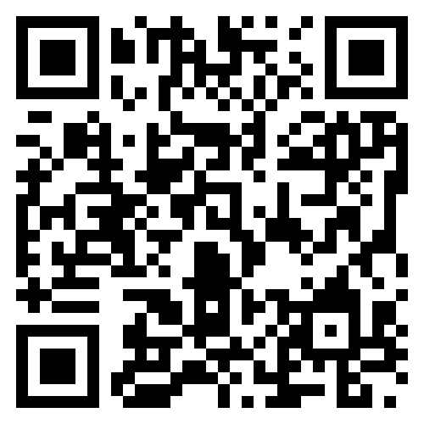
We Have Free Reference Material
Reference training material
Policy template material
Capability modeling
Supplier education material
Self-certification checklists
Over 100 webinars
Over 1,000 other documents in multiple languages
Notes:
Organizations can use free policy templates, training materials and self-certification checklists. The reference library also includes supplier education and webinars, so teams have materials to help them get started.

Slide 16
Our standards are the international baseline for quality in open source license compliance and security assurance programs.
Our guides and reference material helps people solve compliance challenges.
Our community provides a space to share knowledge.
Notes:
The standards provide a common baseline. The reference materials support implementation, and the community offers a place to ask questions and learn from others’ experience.

Slide 17
Evolution in Practice
Recent updates
Notes:
Let’s look at how this work is developing, especially around AI, regulation and SBOMs.

Slide 18
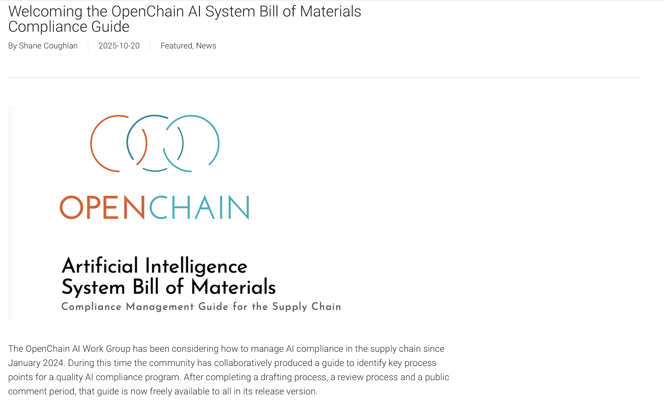
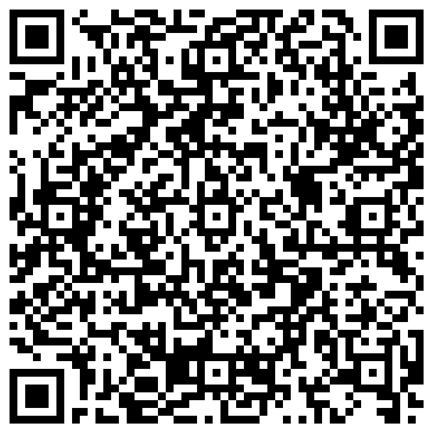
October 2025 — AI SBOM Compliance Guide 1.0
Notes:
OpenChain released version 1.0 of its AI SBOM Compliance Guide in October 2025. It identifies key process points for managing AI compliance in the supply chain. This gives organizations a starting point for discussing responsibilities and the information they need to maintain.

Slide 19
Addressing the CRA (Regulation (EU) 2024/2847)
OpenChain ISO/IEC 5230 and ISO/IEC 18974 asked for record-keeping before Cyber Resiliency Act (CRA) made it into a requirement.
OpenChain ISO/IEC 5230 and ISO/IEC 18974 require companies to create and archive verification materials around open source license compliance and security assurance.
The Cyber Resilience Act’s main obligations apply from 11 December 2027, with reporting obligations already applying as of 11 September 2026.
September 11, 2026, OpenChain released Cyber Resilience Act (CRA) Requirements and Checklist 1.0
https://openchainproject.org/cracompliance
Notes:
OpenChain released the CRA Requirements and Checklist 1.0 on 11 September 2026. It supports preparation for the EU Cyber Resilience Act’s reporting obligations, which began applying on that date. The main obligations apply from December 2027.
The checklist builds on familiar practices, including keeping verification records and assigning responsibilities.

Slide 20
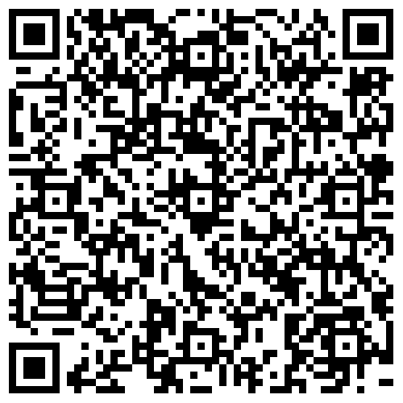
Cross-Industry SBOM Quality Guide Concept
April 2025, The OpenChain Telco Work Group has released Version 1.1 of the Telco SBOM Guide
October 2026, The Linux Foundation released the OpenChain Automotive Software Bill of Materials (SBOM) Framework
Notes:
SBOM means Software Bill of Materials. Its value depends on whether the information is useful to the people receiving it.
The Telco SBOM Guide reached version 1.1 in 2025. This month, the Automotive SBOM Framework 1.0 added guidance for creating and sharing SBOM information across automotive supply chains. These efforts bring industry experience into shared guidance.

Slide 21
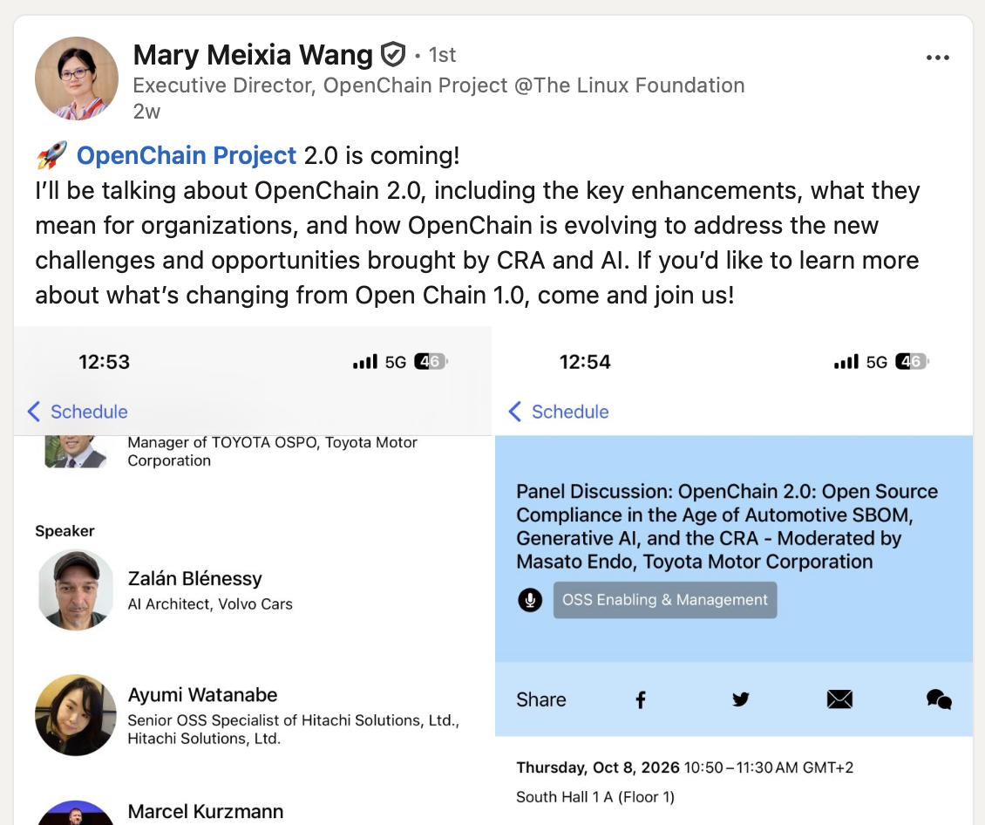
OpenChain Project 2.0 is coming!
OpenChain 2.0: Open Source Compliance in the Age of Automotive SBOM, Generative AI, and the CRA
Open Source Summit Europe
7-9 October, 2026, Prague, Czechia
Notes:
OpenChain Project 2.0 points to the project’s next stage. The discussion brings together established compliance work with emerging needs around automotive SBOMs, generative AI and the CRA.

Slide 22
Support Network
Notes:
Organizations have support as they put these ideas into practice. Let’s briefly look at the people and services around the project.

Slide 23
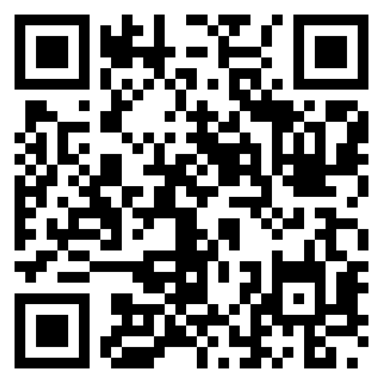
Our Community Work Groups
Core Work Groups
Education (Autumn 2020~)
Specification (Spring 2016~)
Community Work Groups
AI (January 2024~)
Automation (Summer 2019~)
SBOM (July 2024~)
Industry-Specific Work Groups
Automotive (Summer 2019~)
Telco (Spring 2021~)
Regional User Groups
China (Sept 2019~)
Germany (Jan 2020~)
India (Sept 2019~)
Japan (Dec 2017~)
Korea (Jan 2019~)
Meridian 22 (Sept 2025~)
Taiwan (Sept 2019~)
UK (June 2020~)
Southeast Asia(Sep 2026~)
Notes:
OpenChain has regional groups, industry groups and groups focused on particular topics. Southeast Asia provides a local entry point into this wider community. We can bring regional questions to global discussions and share what we learn locally.

Slide 24

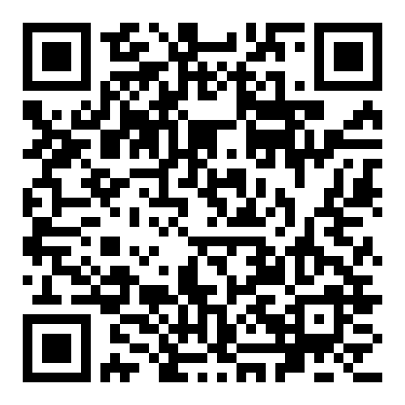
25 Global Ambassadors Supporting Our Work
Notes:
OpenChain’s ambassadors help people connect with the project. They extend the community’s reach and help introduce its work to new audiences.

Slide 25

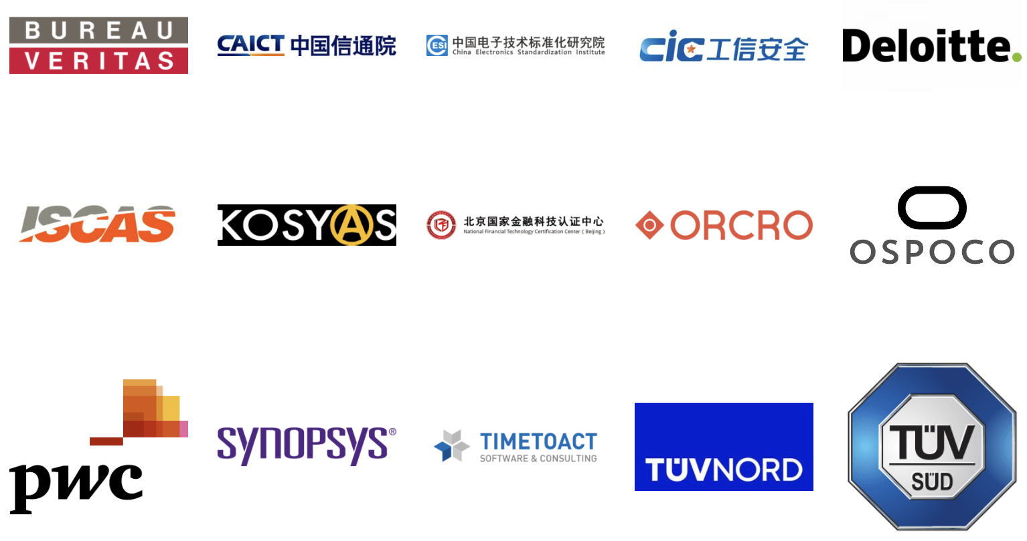
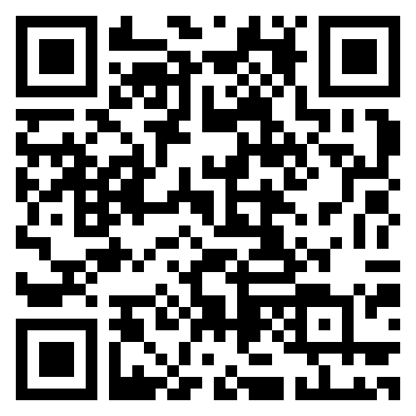
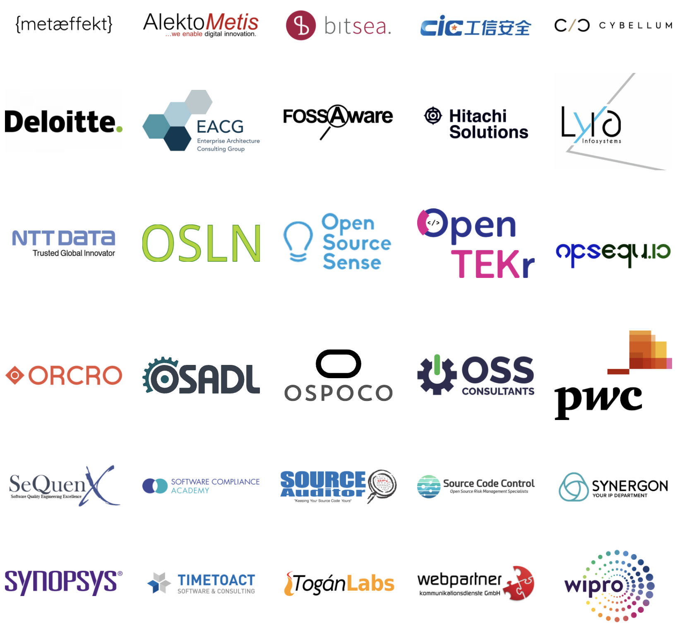

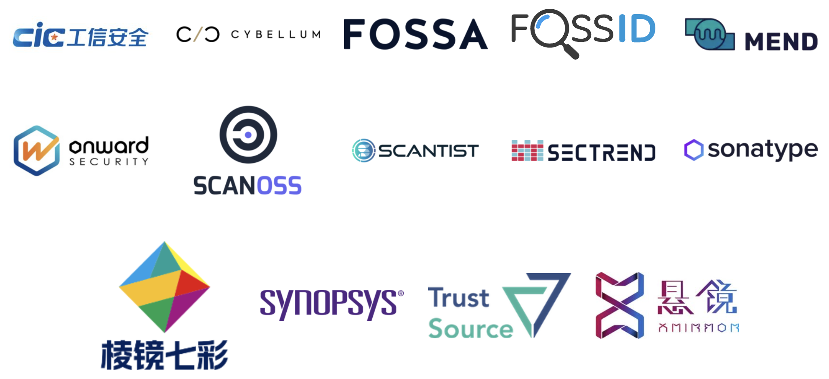
We Have Commercial Support
Legal Providers
Third-Party Certification
Consultancies
Tooling / Automation
Notes:
Commercial support is also available, including tooling, consulting and third-party certification. Organizations can choose the support that matches their needs and internal capabilities.

Slide 26
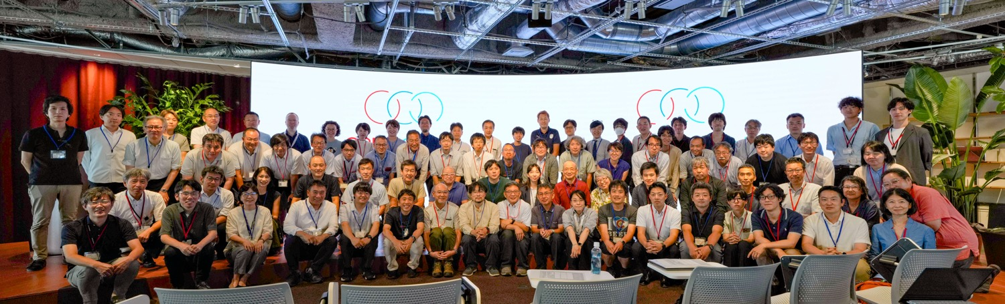
You Are The Community
Notes:
The community grows through the people who participate. Questions, feedback and implementation experience all help shape its work.

Slide 27
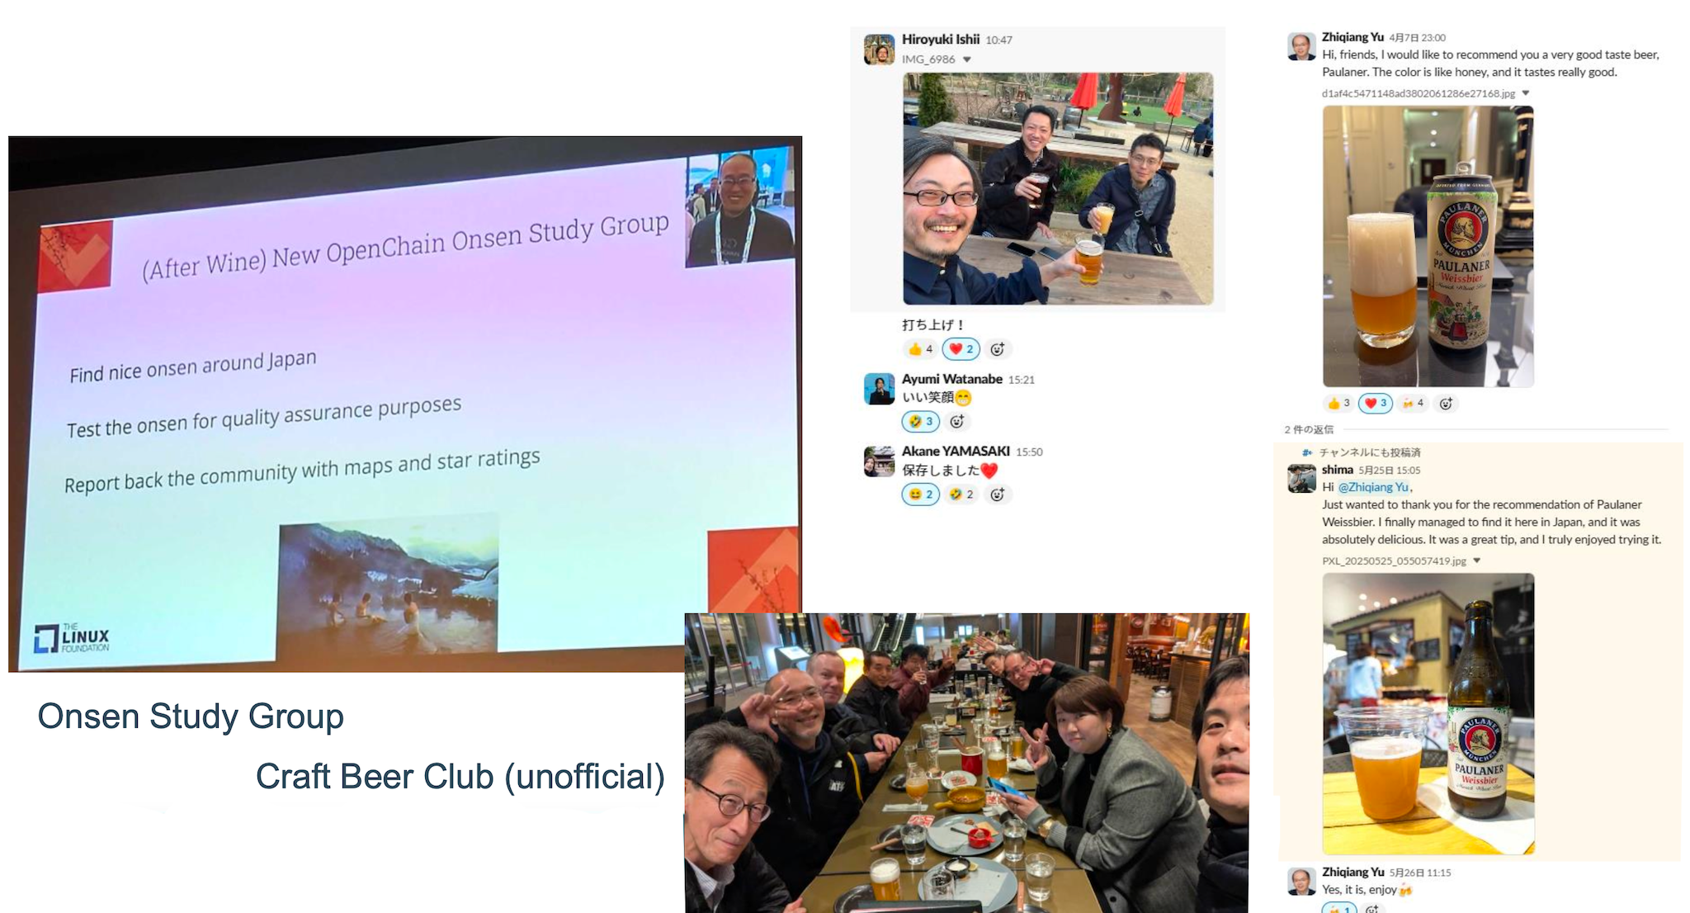
Everyone Is Always Welcome!
New in Korea: Makkoli Study Group
Notes:
You do not need to be an expert to join. You can start by listening, asking a question or sharing a challenge from your own work.

Slide 28
OpenChain Southeast Asia Work Group
Set up the work group, hold monthly calls and engage local partners
  Monthly online calls on the fourth Thursday, 20:00–21:00 Singapore Time
Explore regional needs and share practical experience
  Share OpenChain in local events and connect interested organizations.
  Co-host local events to feature partners sharing their own practices and lessons learned.
Connect the region with the global community and experts for collaboration
  Explore regional regulatory needs, compared with the OpenChain EU CRA Checklist
  Expand multilingual resources and support
Notes:
For Southeast Asia, we’ll begin with monthly calls and relationships with local partners. Our planned meeting time is the fourth Thursday of each month, from 8 to 9 p.m. Singapore time.
We also want to join regional events and organize local meetups with partners. These can help us understand local needs and learn from organizations already applying OpenChain.
Our collaboration with the global community can explore three areas: regional regulatory needs, drawing on the EU CRA Checklist， Cybersecurity Act in Singapore, Thailand and Vietnam; multilingual resources and support; and industry implementation experience.
We’d like your input on which of these would be most useful in your country or organization.

Slide 29
Follow and Participate
Our calls are open and publicly listed.
We publish a recording of every meeting not under Chatham House Rule.
We provide access to work groups, special interest groups and local work groups via mailing list.
Monthly online calls: https://openchainproject.org/participate
Mailing List: https://lists.openchainproject.org/g/southeastasia-wg
Github: https://github.com/OpenChain-Project/OpenChain-SouthEastAsia-WG
Notes:
The links here take you to our meetings, regional mailing list and GitHub repository. Please join the mailing list to stay involved, and use these channels to suggest topics or share experience.

Slide 30
Let’s Talk More
Thank you!
Notes:
Thank you. I’d like to open the discussion: what challenges are you seeing in your organization, and where could this regional group help? We’d also welcome ideas for local partners and future sessions.

